Slide 1
3D Scanning and Spatial Learning Volumetric Capture
Marcel Bruckner, Kevin Bein, Moiz Sajid

Slide 2
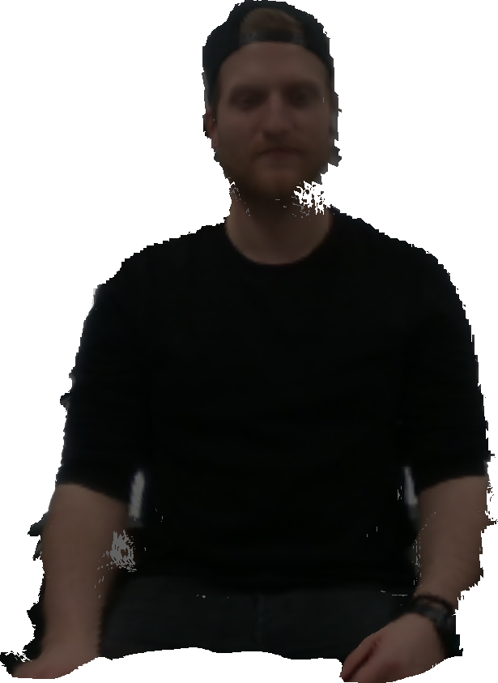
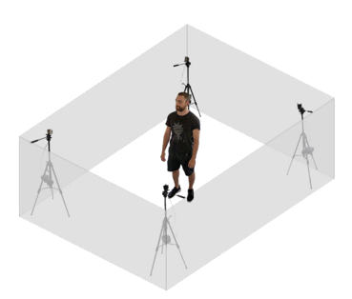
Volumetric Capture
Realtime 3D reconstruction using multiple cameras

Slide 3
Reconstruction Pipeline
RGB-D frame capture
Voxelgrid TSDF
Marching Cubes surface
Correspondence matching
Camera calibration

Slide 4
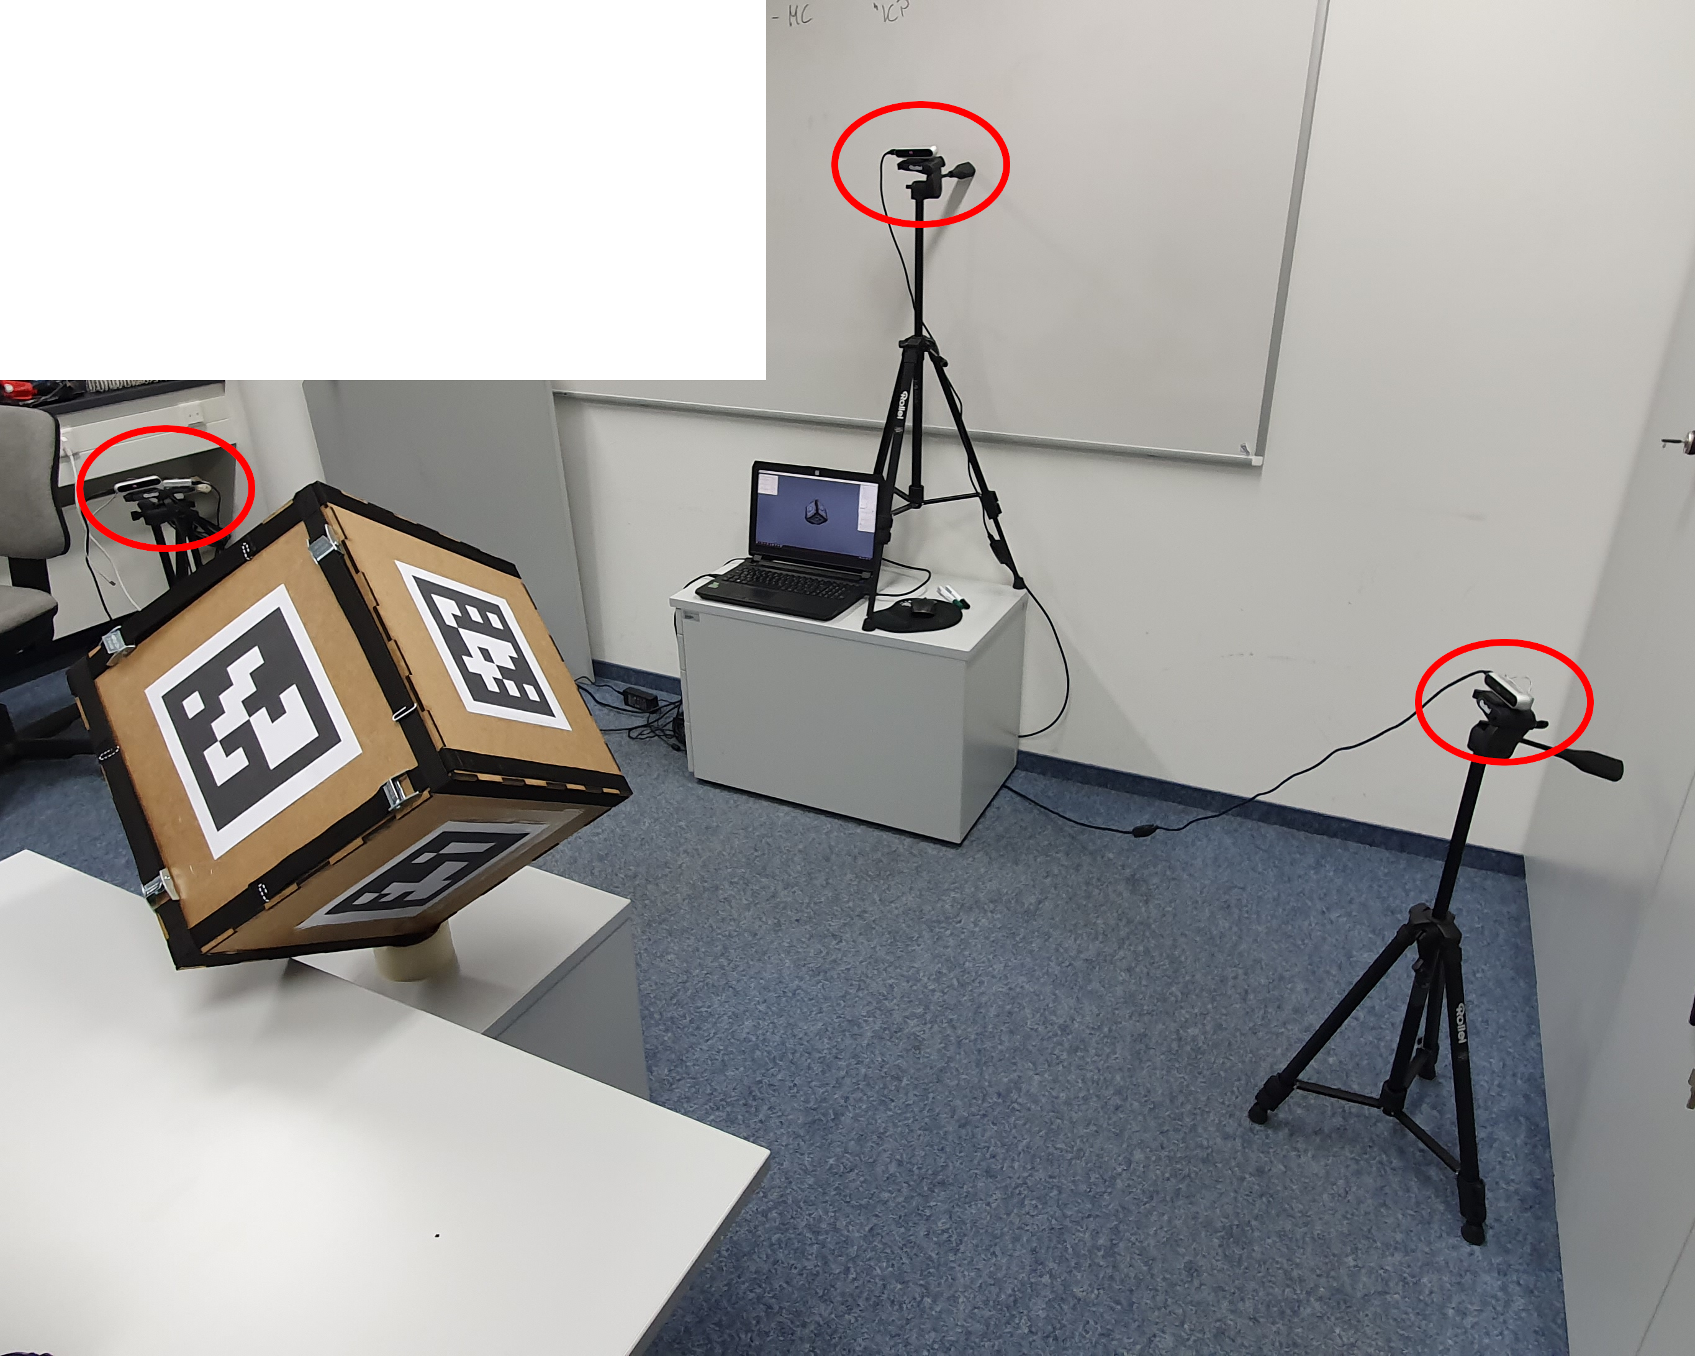
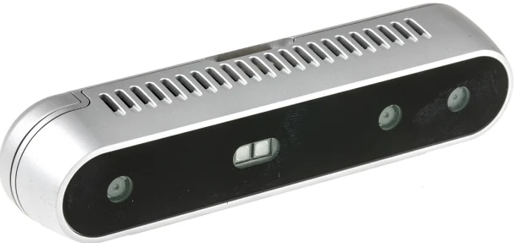
RGB-D Frame Capture
Hardware setup
4 Intel RealSense Depth Camera D415

Slide 5
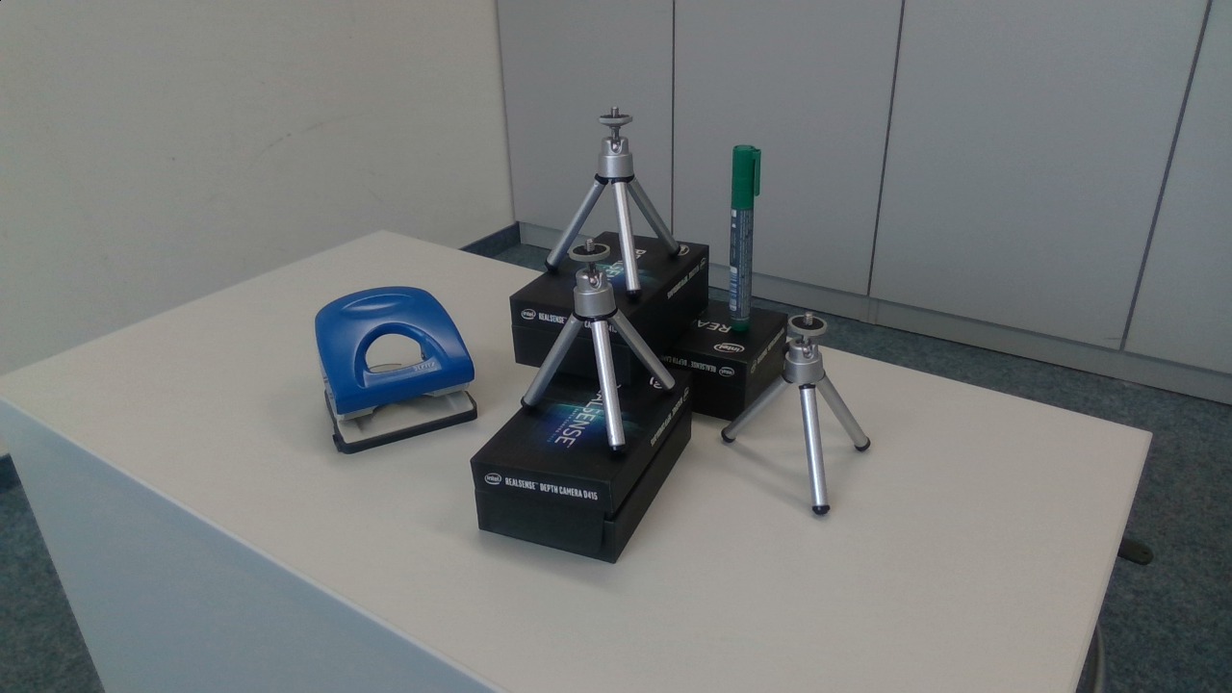
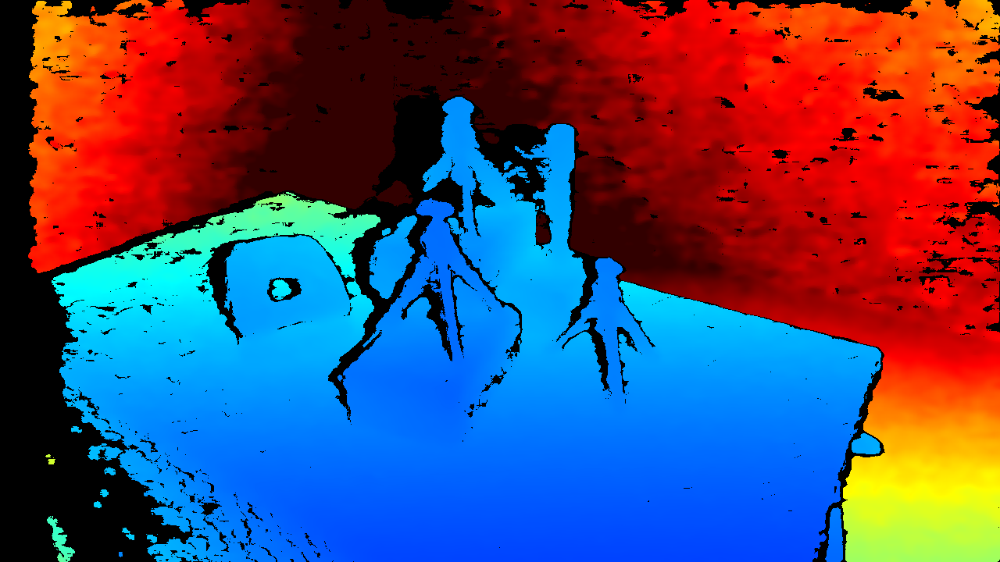
RGB-D Frame Capture
Frame aquisition
1920x1080 RGB resolution
1280x720 active stereo depth

Slide 6
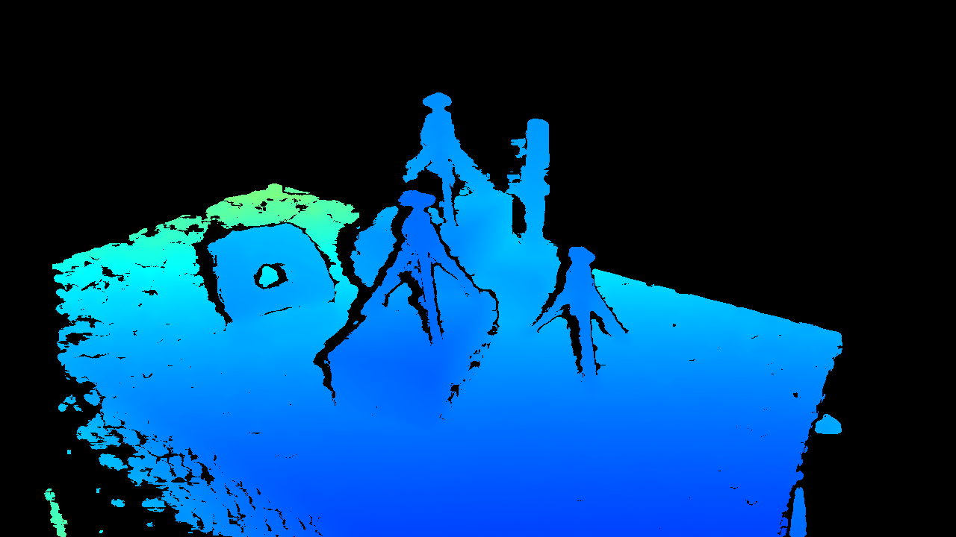
RGB-D Frame Capture
Depthmap preprocessing
Original
Threshold filtered

Slide 7
RGB-D Frame Capture
Final pointclouds
Add video of single pointcloud

Slide 8
RGB-D Frame Capture
Tried approaches
Holefilling filter
Spatial filter
Edge enhancement filter
Add images of different filters

Slide 9
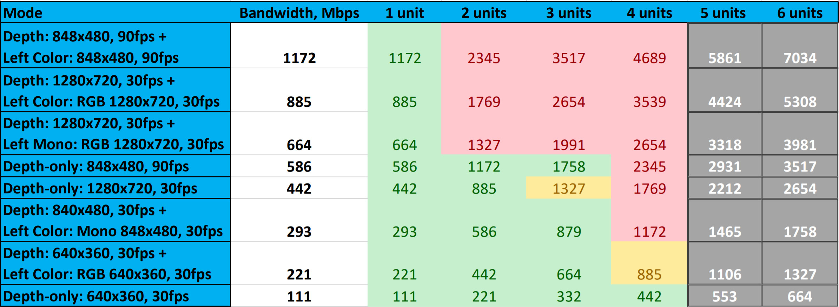
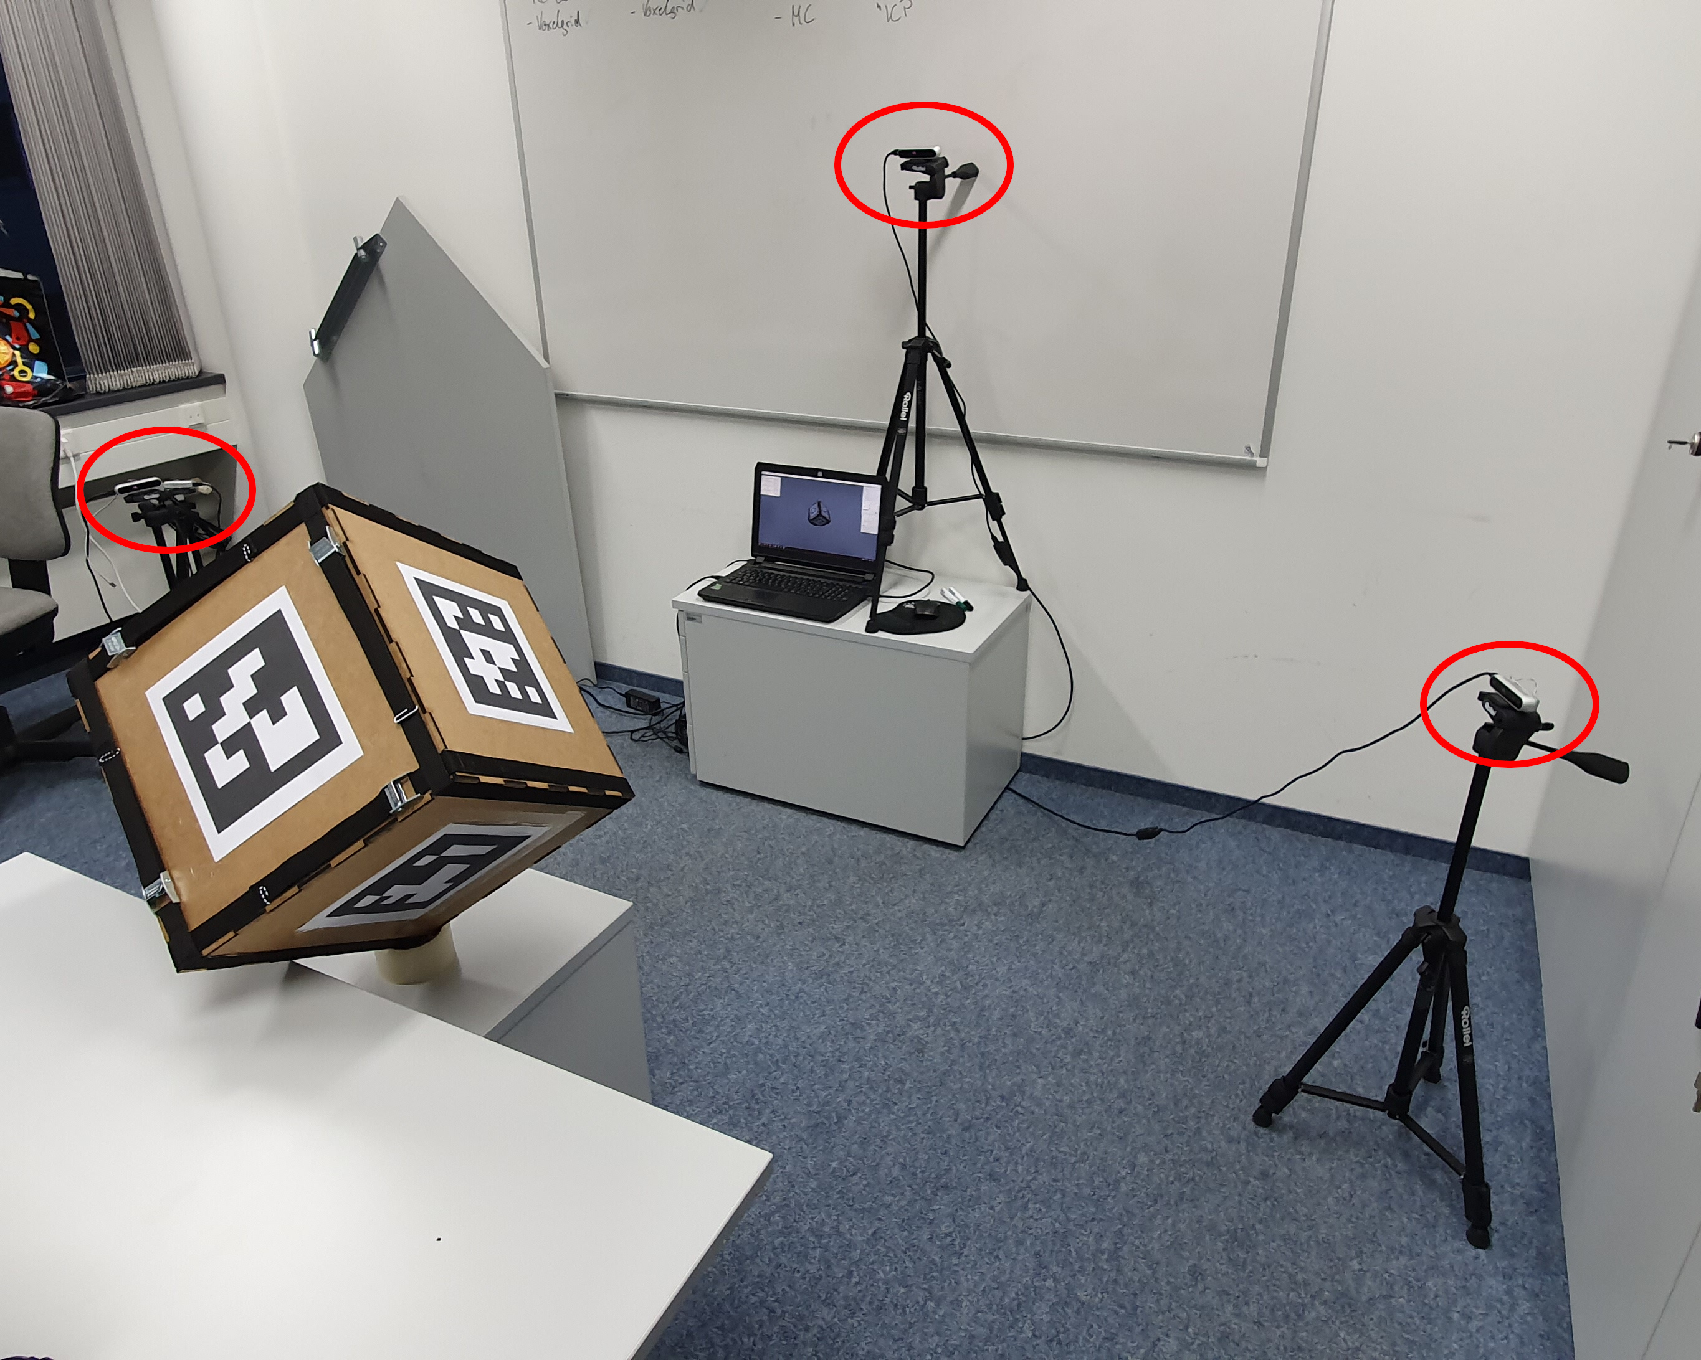
RGB-D Frame Capture
Difficulties
Bandwidth limitations

Slide 10

Correspondence Matching
ArUco markers
Square markers with unique ids
Easy detection using OpenCV
Subpixel perfect corners in color stream

Slide 11
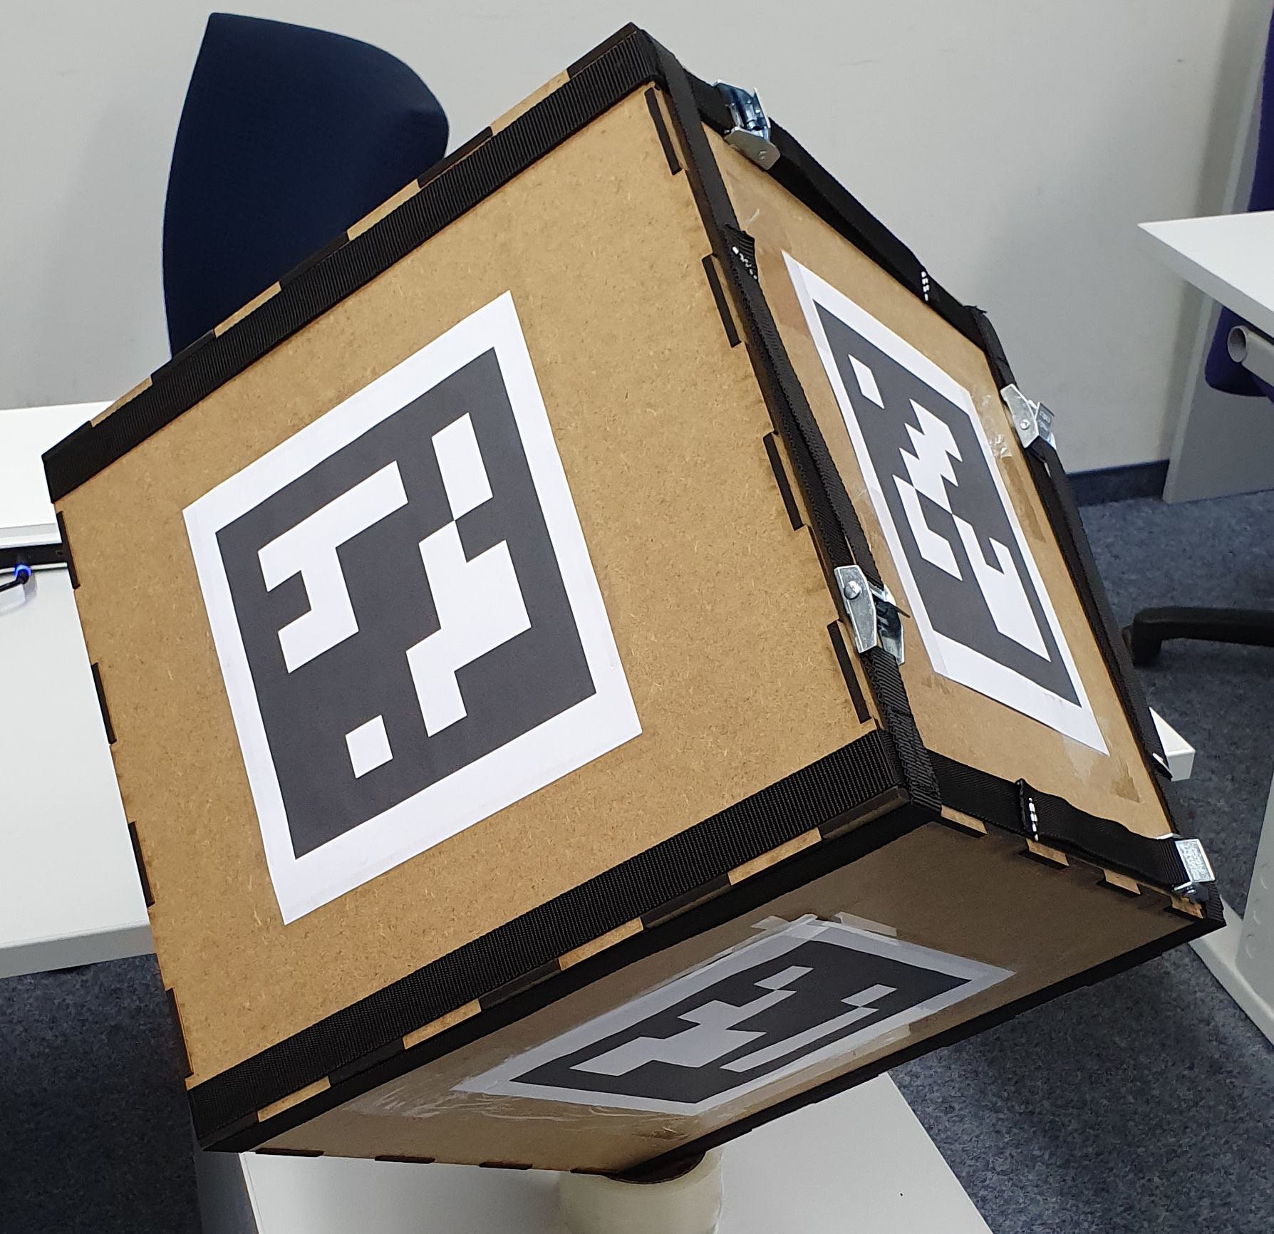
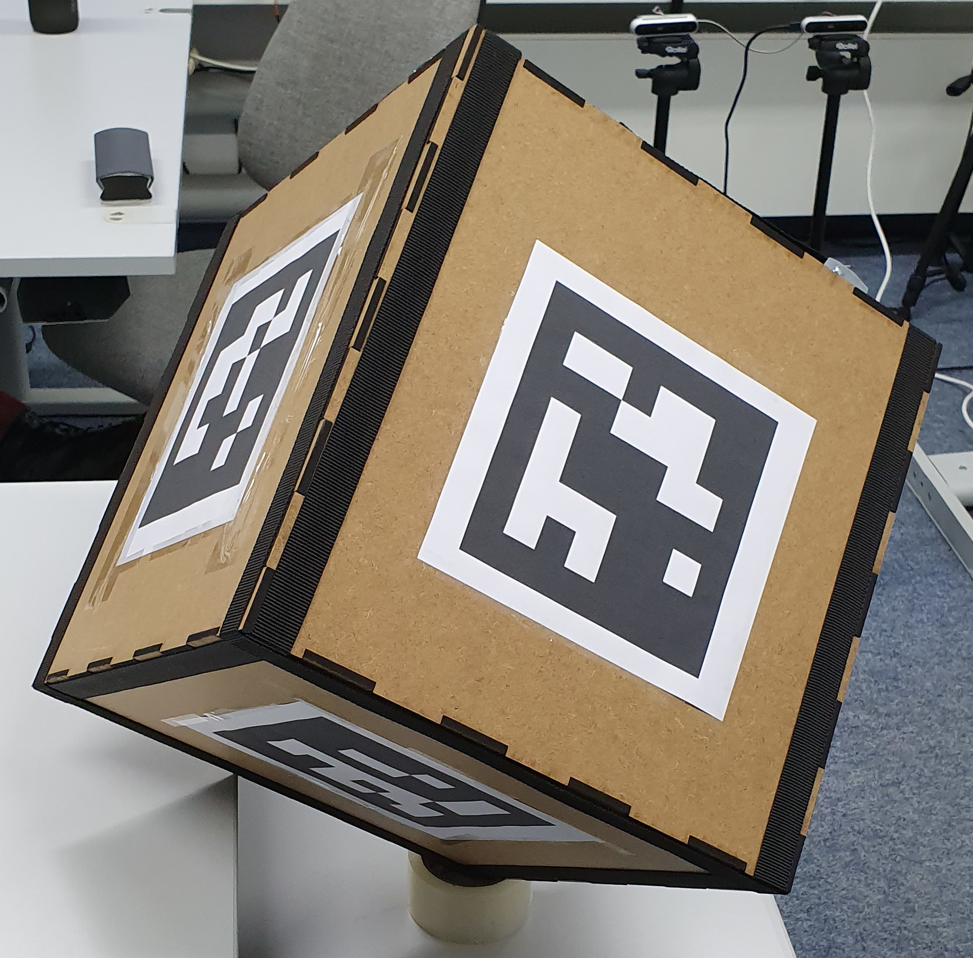
Correspondence Matching
Marker cube
6 sides, one marker per side
Easily detectable even from steep angles
Overlap of detected markers used for pose estimation

Slide 12
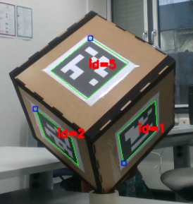
Correspondence Matching
Marker cube

Slide 13
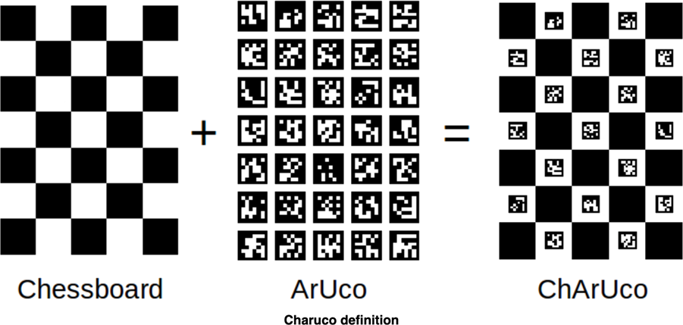
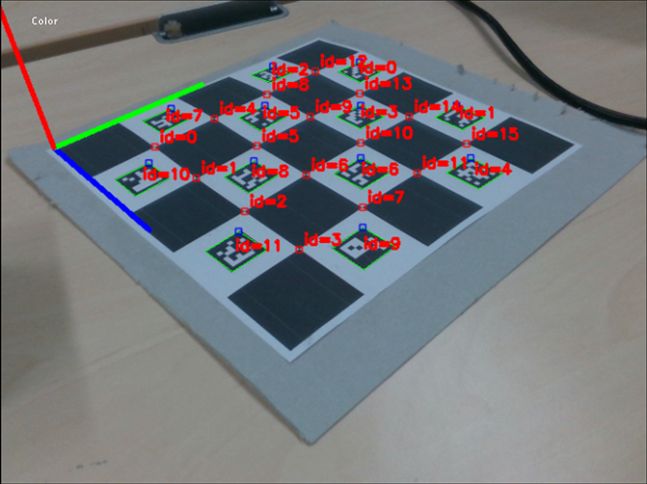
Correspondence Matching
Tried approaches
ChArUco marker board
Allows simultaneous marker detection and pose estimation
Tradeoff between number of markers and marker size
Not robust enough

Slide 14
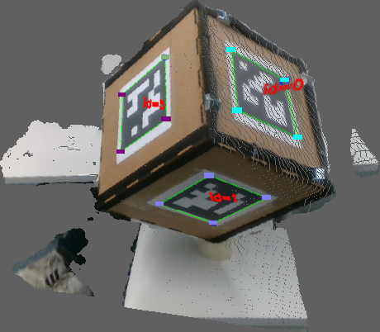
Camera calibration
3D marker positions
Backprojection of ArUco markers into 3D pointcloud
Subpixel perfect pixel location allows robust backprojection
Align 3D marker positions of all cameras

Slide 15

3D Pose Estimation
Procrustes
Align two objects using known correspondences
Translation: Vector between centers of gravity

Slide 16
3D Pose Estimation
Procrustes
Align two objects using known correspondences
Scale: Avgerage distance to center of gravity

Slide 17
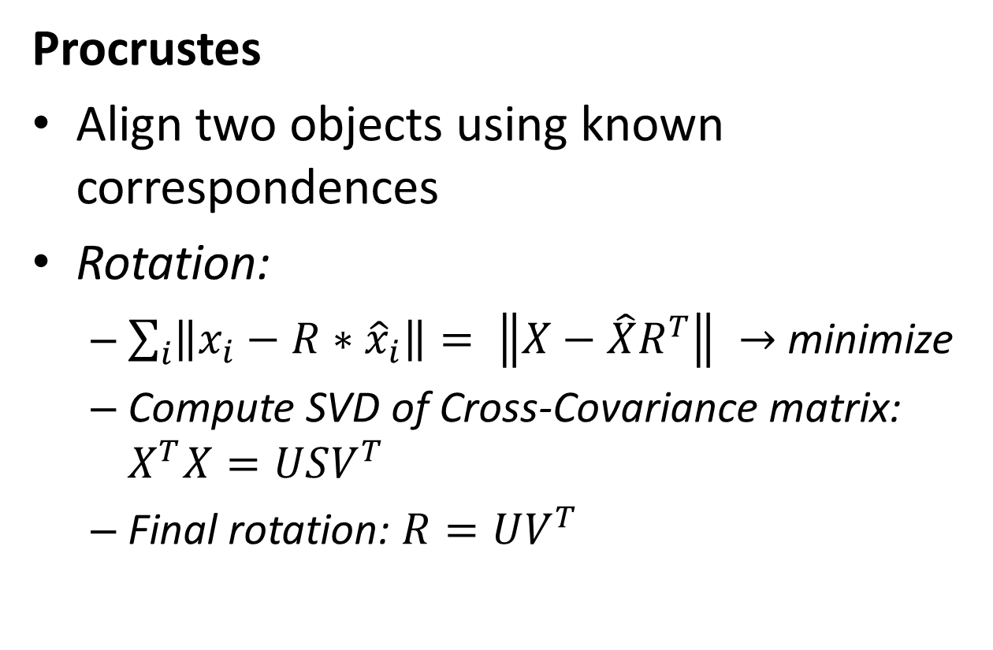
3D Pose Estimation
Procrustes
Align two objects using known correspondences
Rotation:
$\sum_{i}{\left\|x_{i}−R∗{\hat{x}}_{i}\right\|}= \left\|X−\hat{X}R^{T}\right\| →$ minimize
Compute SVD of Cross-Covariance matrix: $X^{T}X=USV^{T}$
Final rotation: $R=UV^{T}$

Slide 18
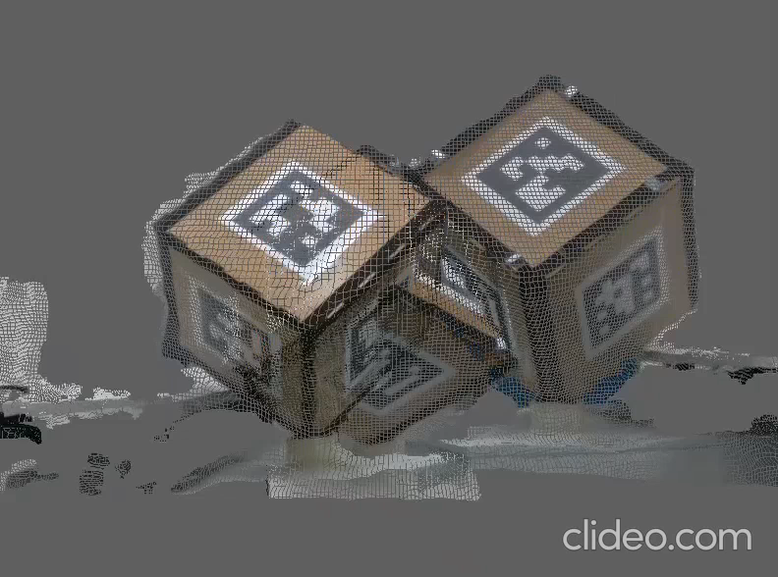
3D Pose Estimation
Procrustes
Procrustes is not robust enough
MSE after alignment still fairly high

Slide 19
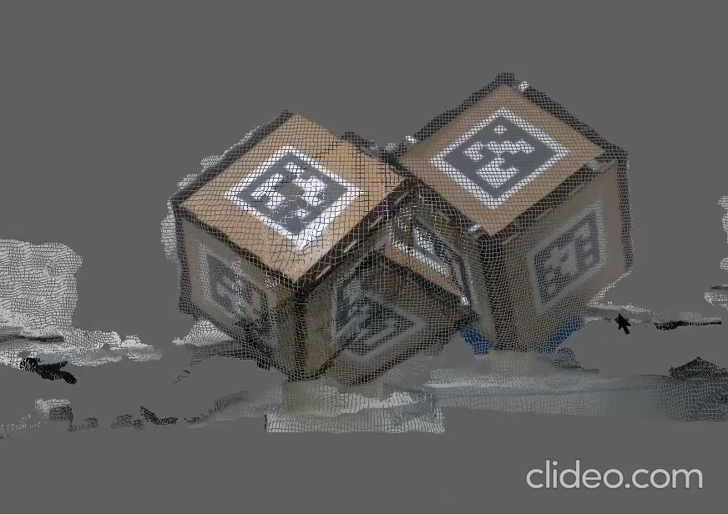
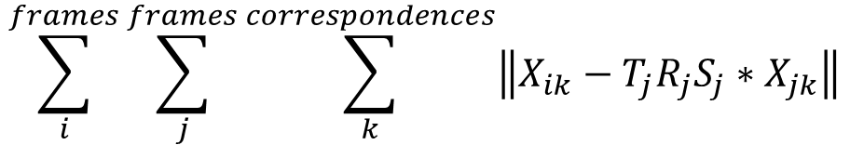
3D Pose Estimation
Point to Point Error
Use procrustes as an initialization
Optimize:
$$\sum_{i}^{frames}{\sum_{j}^{frames}{\sum_{k}^{correspondences}{\left\|X_{ik}−T_{j}R_{j}S_{j}∗X_{jk}\right\|}}}$$

Slide 20
Camera Calibration
Difficulties
Visualization of calibration results
Ceres for Point to Point optimization
Further work
FLANN for correspondence matching
ICP for further alignment

Slide 21
Voxelgrid
Aligned frames get fused into voxelgrid
Calculate TSDF of the integrated frames
Weighted averaging of the TSDF values
Implicit surface representation

Slide 22
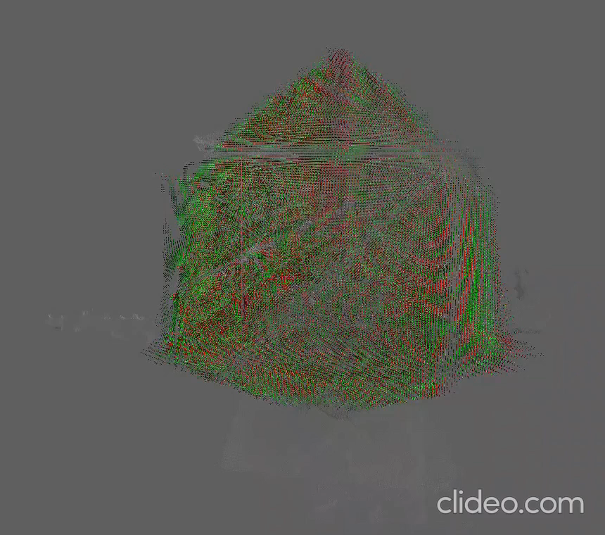
Voxelgrid
Aligned frames get fused into voxelgrid
Calculate TSDF of the integrated frames
Weighted averaging of the TSDF values
Implicit surface representation

Slide 23
Voxelgrid
Difficulties
CPU approach as a proof of concept
Move all calculations to GPU for parallelization
Had to learn OpenGL compute shader programming for realtime
Tradeoff between resolution and frame rate
Find good truncation distance to lower artifacts

Slide 24
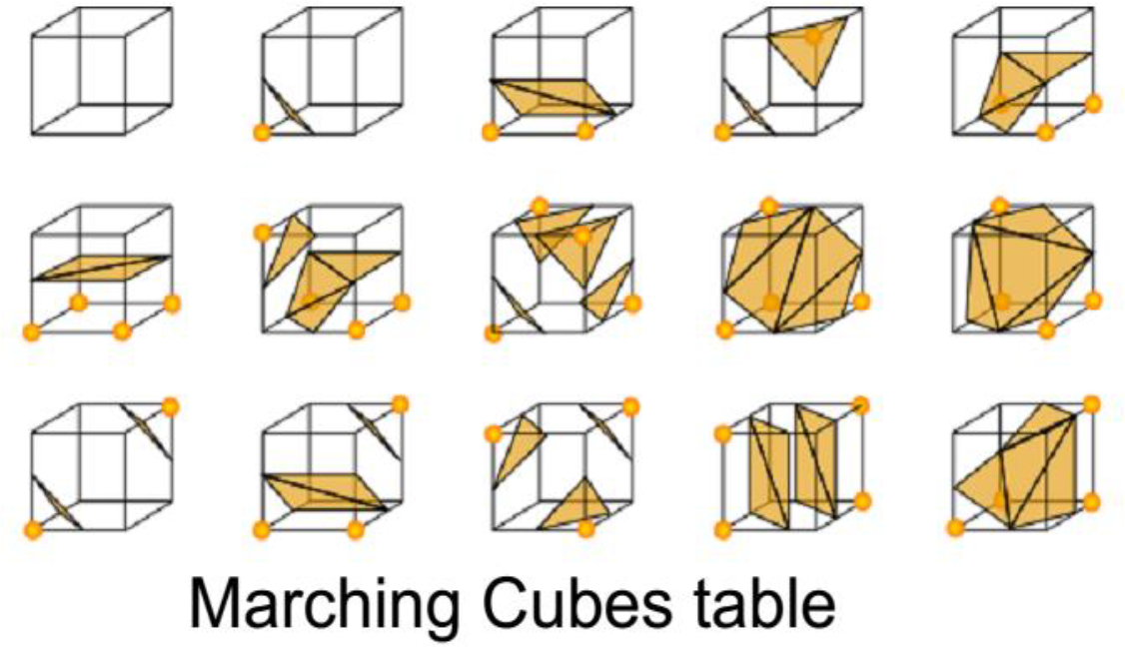
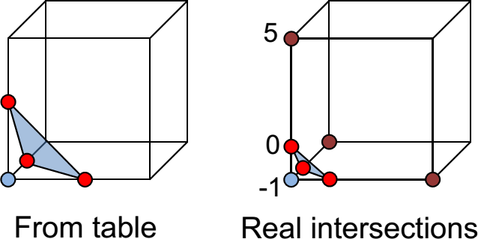
Marching Cubes
Converts an iso-surface of a tri-variat scalar function to a polygonal mesh
Uniform sampling (Voxelgrid) of the implicit surface
Determine zero crossings for every grid cell

Slide 25
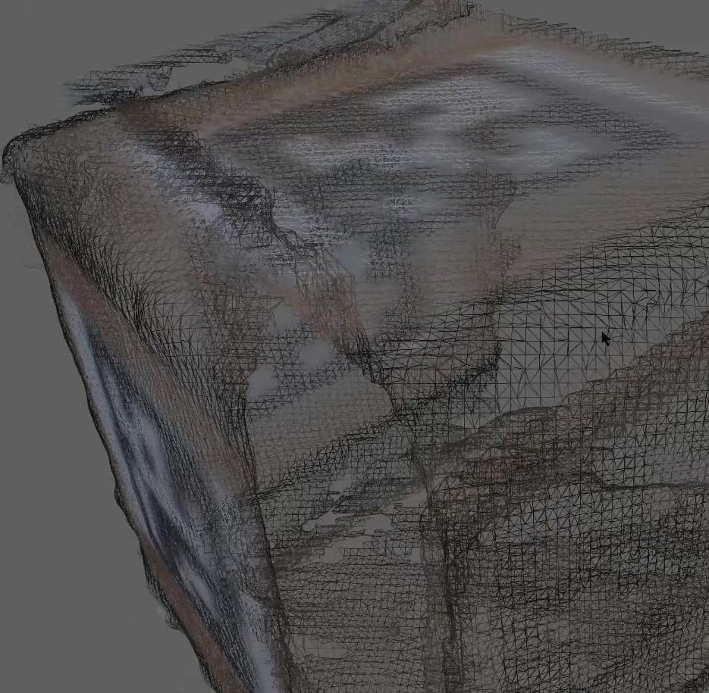
Marching Cubes
Final result is a triangulated mesh representing the implicit surface

Slide 26
Marching Cubes
Difficulties
CPU approach as a proof of concept
Move all calculations to GPU for parallelization
Had to learn OpenGL compute shader programming for realtime
How to approach uninitialized voxels
2-pass compute shader to tackle memory issues

Slide 27


Final results

Slide 28
Volumetric Capture
RGB-D frame capture
Voxelgrid TSDF
Marching Cubes surface
Correspondence matching
Camera calibration
If you are interested in a live reconstruction of yourself, feel free to come to our office at 02.07.31!

Slide 29
Thank you for your attention!

